Slide 1

LOAN PREDICTION MODEL
Group 2 mini project models an analysis of the borrower’s eligibility/chance of being granted a loan

Slide 2


GROUP 2 MEMBERS
JUDITH MALEPE
CAROLINE AYIEKO
OMOBOLANLE ADEYEMI
CHEGE JACINTA
PURITY CHEPKURUI
OLUWATOSIN EHINDERO
ALOZIE IJEOMA
NKECHI IJEOMA
CLEMENCE RUHI

Slide 3
Agenda
Problem statement
Objectives
Approach and model development
Results and findings
Conclusion
References

Slide 4
Problem statement
The current economic downturn has resulted with an increased need for consumer credit as people find themselves turning more to financial institutions for loans.
One of the key factors which financial institutions use to assess the borrower’s eligibility to qualify for credit is by creating and designing prediction models to provide an automatic assessment upon input of certain variables to model the borrower’s chances of qualifying for the loan.
This method is a less time-consuming process and quickens the loan shopping process.

Slide 5

Objectives
The main objective of the model is to provide an automation of loan processing system for financial institutions
Help save time used by the financial institutions to check if a client qualifies for the loan
Binary response of the target variable, that is, loan approval status
Our target variable is loan status

Slide 6
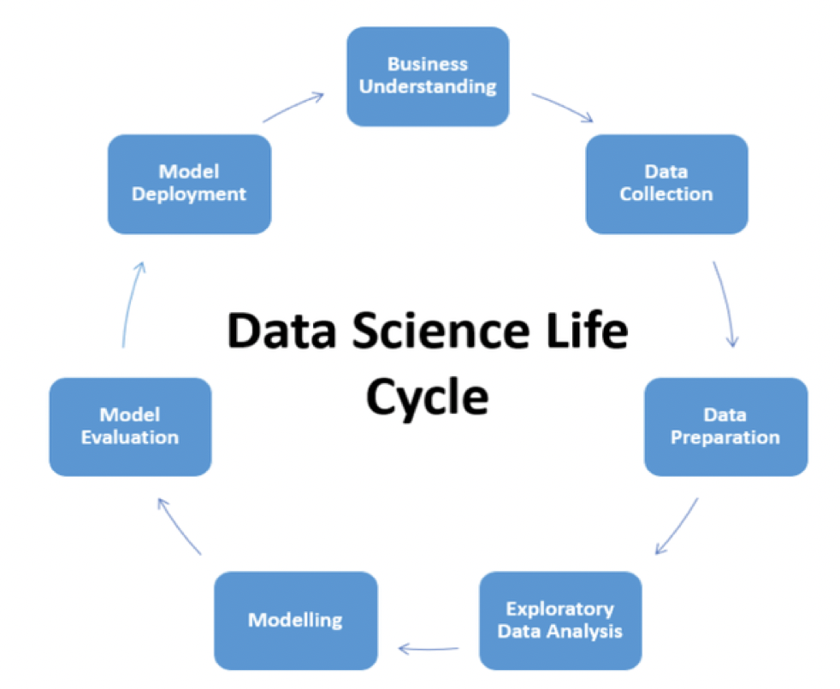
Model development approach
Data science life cycle [1]

Slide 7

Model development
Business understanding: understanding the business process, the problem, business objective and criteria for loan model solution
Data collection: producing a dataset
Data preparation: cleaning of data
Exploratory data analysis: analyzing data using graphs
Modelling and evaluation:
Generate and assess model
Determine Accuracy:
Random forest & Logistic regression compared
Model deployment: testing the model

Slide 8
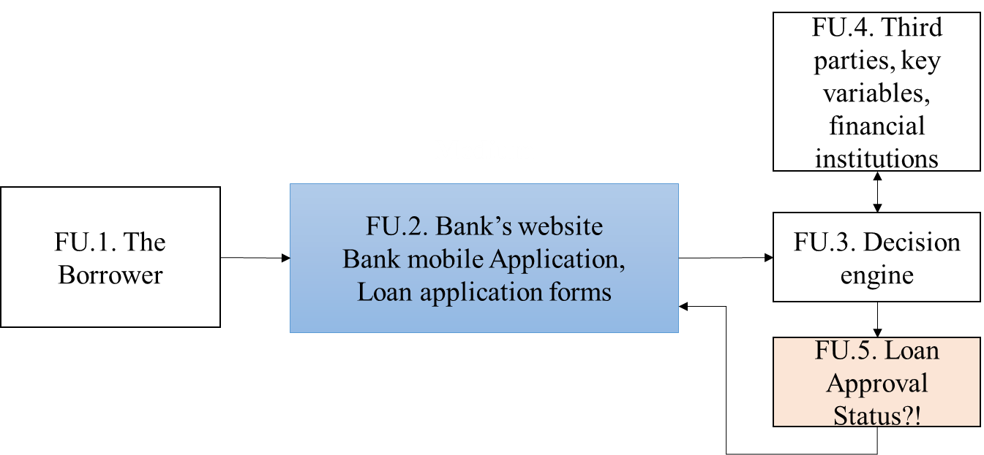
Business understanding
Illustration of the Business process

Slide 9
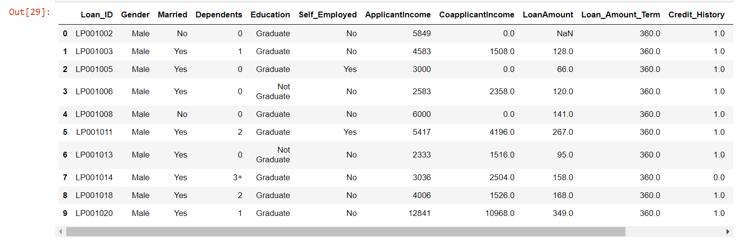
Data collection and preparation
Producing a data set and cleaning data

Slide 10

Machine learning tools
The two techniques that we used to compare our accuracy for predicting if a person has qualified for the loan
Logistic regression : is a technique borrowed by machine learning from the field of statistics. It is the go-to method for binary classification problems, (problems with two class value).
Random Forest: Random forest is a tweak on this approach where decision trees are created so that rather than selecting optimal points, suboptimal splits are made by introducing randomness

Slide 11
Features
The variables chosen in the dataset about the borrower are:
Gender
The borrower’s Income
Education
Marital status
No. of dependents
Loan amount
Loan term
Credit history

Slide 12
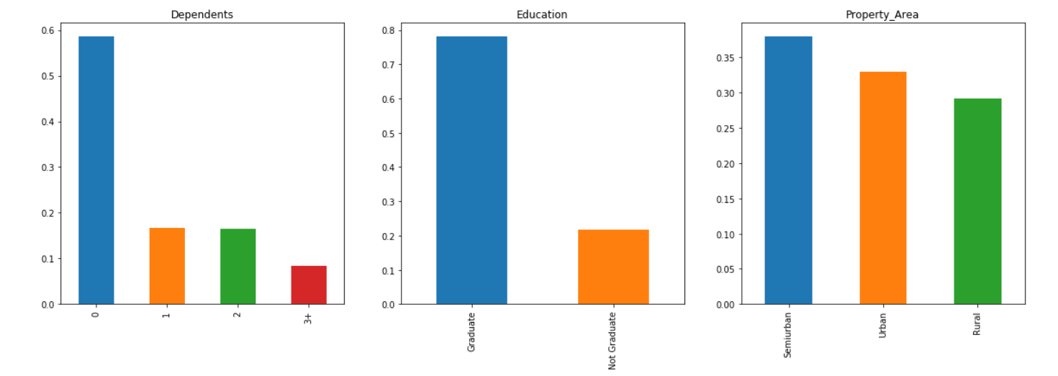
Exploratory data analysis
Analyzing data using graphs

Slide 13
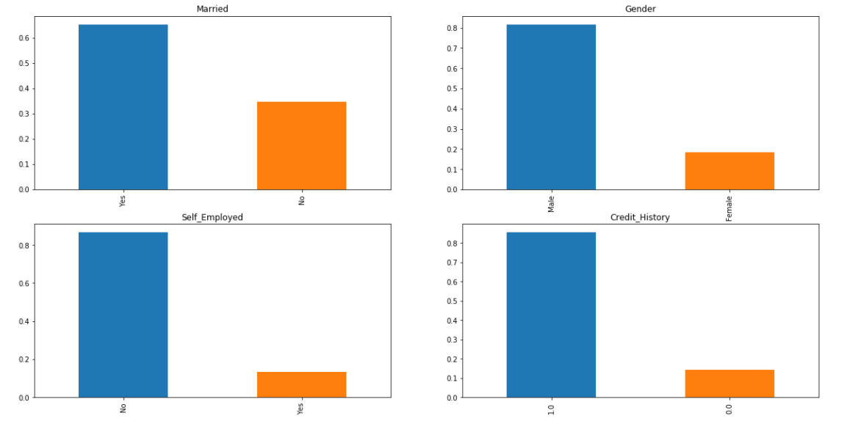
Exploratory data analysis
Analyzing data using graphs

Slide 14
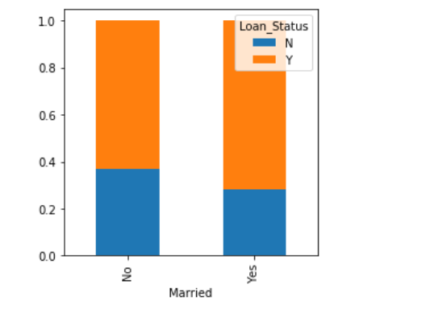
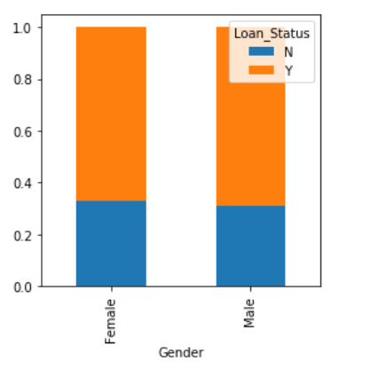
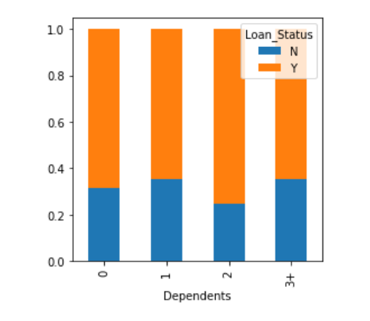
Exploratory data analysis

Slide 15
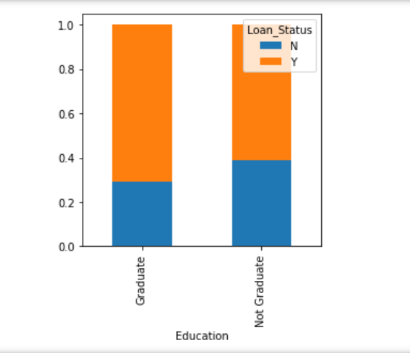
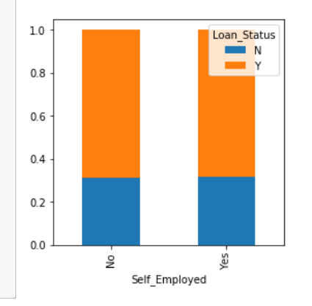
Exploratory data analysis(EDA)

Slide 16
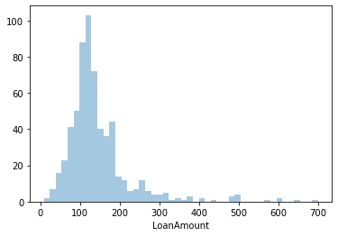
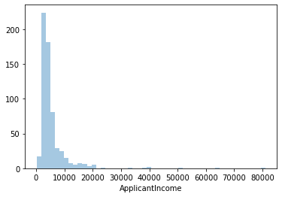
EDA
Analysing data using graphs

Slide 17
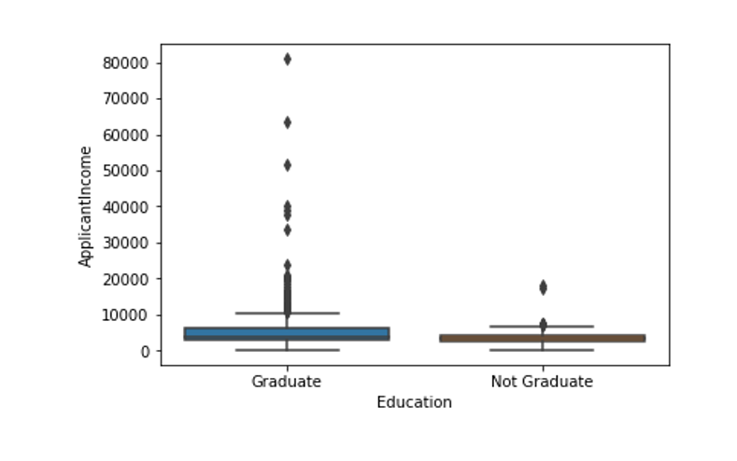
Comparisons of applicant’s income between graduates and not graduate
Graduates have more outliers hence people with huge income are most likely to be educated

Slide 18
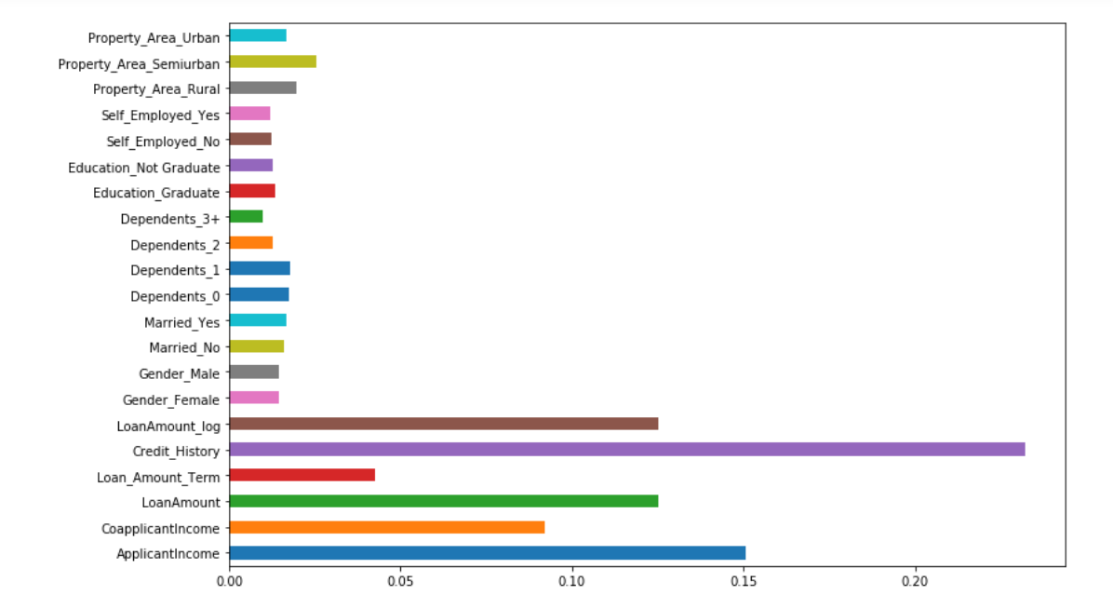
Feature importance
Feature importance: getting rid of variables which are unnecessary to improve model accuracy by selecting features with greater impact. Long bars are more significant than small bars.

Slide 19
Feature importance
Importance features for our case:
Loan amount
Credit history
Co-applicant income
Applicant income
Loan term

Slide 20
Model validation
When using logistic regression model, our accuracy was 78% while using random forest, the accuracy was 77%
Using important features, we retrained our model, and our accuracy went up to 81% from 77% for random forest and for logistic regression, our accuracy went from 78% to 83%.

Slide 21
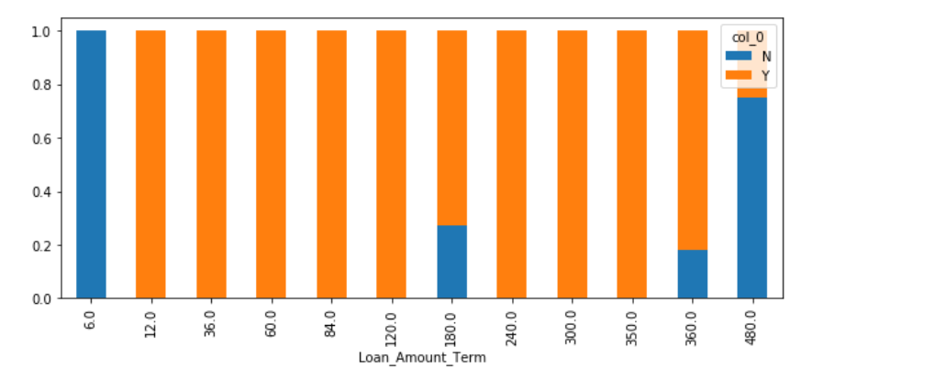
Results

Slide 22
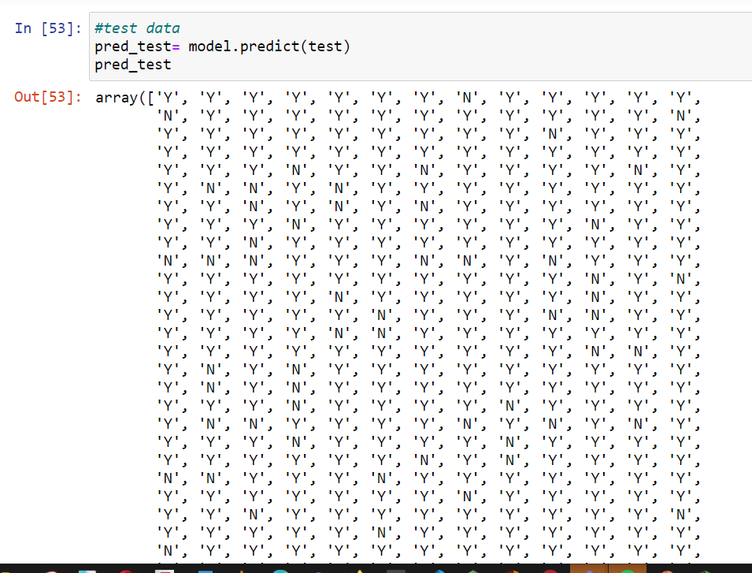
Results

Slide 23
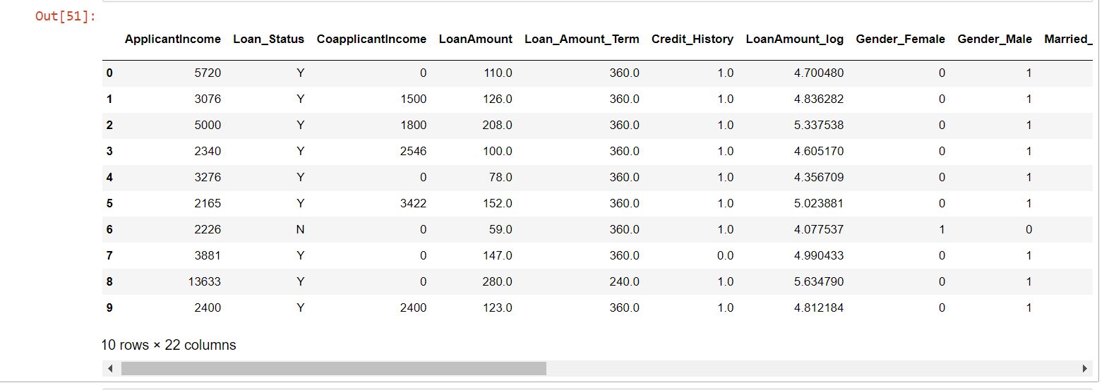
Final results

Slide 24
Conclusion
An automation of the loan processing design was created and used to check the eligibility of the borrower to qualify for a loan.
Applicants with no credit history have almost 100% chance of their loan applications declined.
Model development requires continuous improvement. Data preparation and cleaning, as well as variable engineering/feature importance contributes to model accuracy.
Prediction models quicken the loan application process for financial institutions and reduce the risk of approving people likely to default on their payments at a quicker process

Slide 25
References
[1]. https://medium.com/swlh/complete-life-cycle-of-a-data-science-machine-learning-project-13df81bbd8eb
[2]. Emeto W, Statistical modelling notes, ‘Tech4Dev-DataScience Learning track’, May 2021.06.23 [3]. https://intellipaat.com/blog/tutorial/data-science-tutorial/modeling-the-data/
[4]. Analytic environment - Jupiter Notebook
[5]. Testing and training data - https://www.kaggle.com/altruistdelhite04/loan-prediction-problem-dataset.

Slide 26

Thank you

